Slide 1
Unit -4
Basics of Thermodynamics

Slide 2
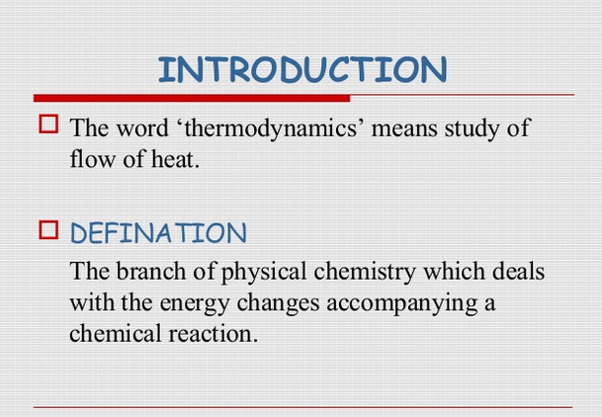

Slide 3
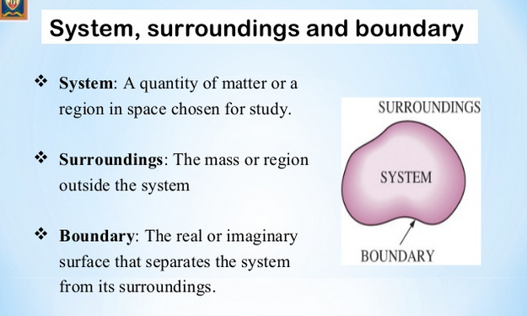
Terms Used in Chemical Thermodynamics

Slide 4
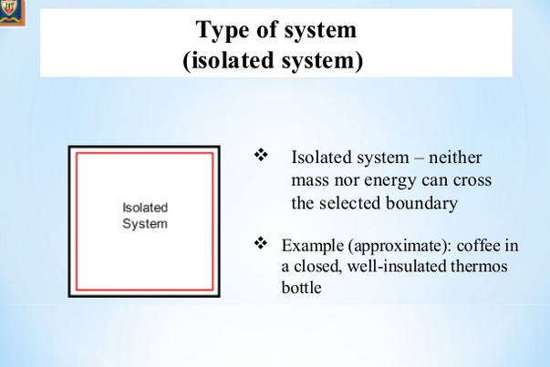

Slide 5
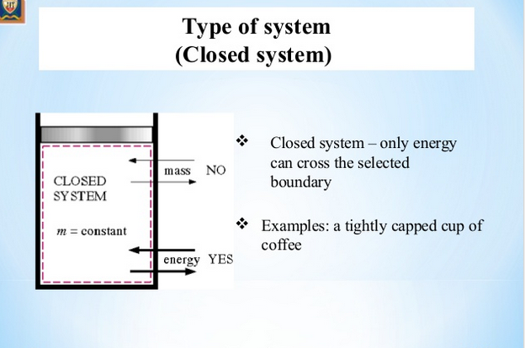

Slide 6
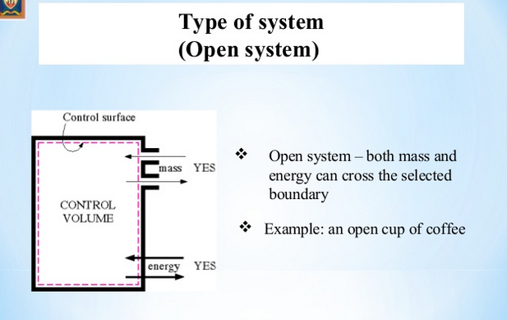

Slide 7
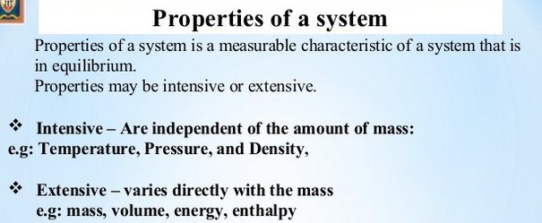

Slide 8
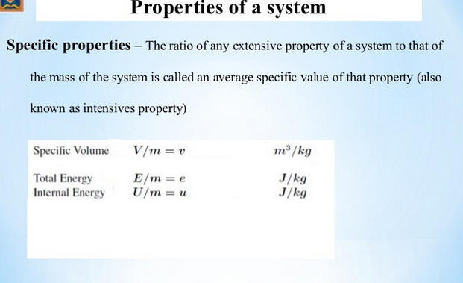

Slide 9
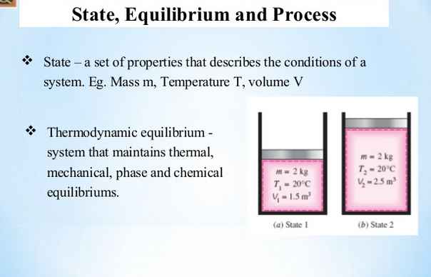

Slide 10
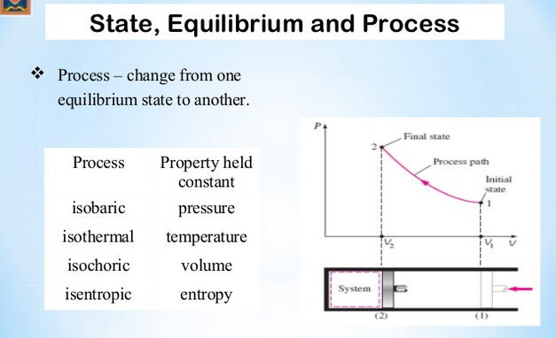

Slide 11
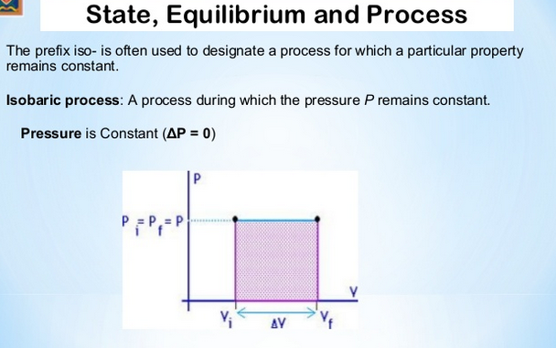

Slide 12
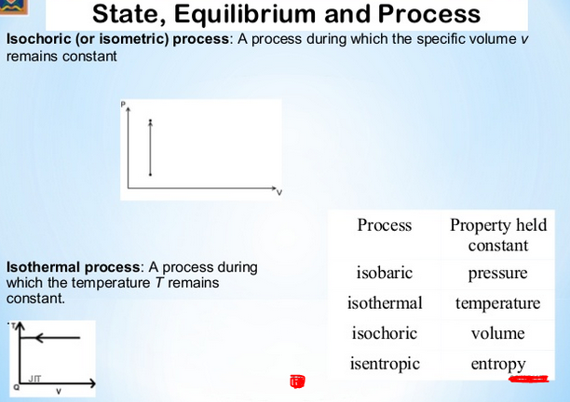

Slide 13
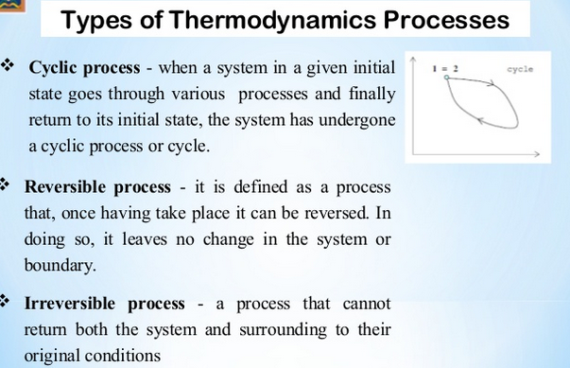

Slide 14
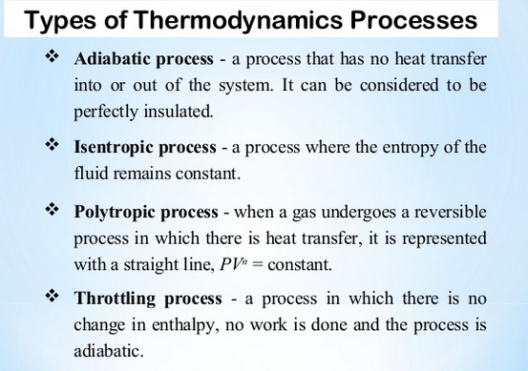

Slide 15
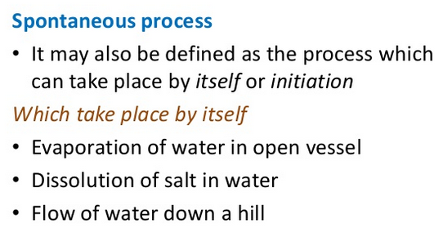
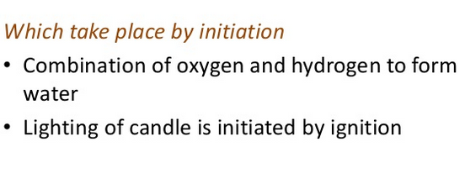
Spontaneous and Non-Spontaneous Process

Slide 16
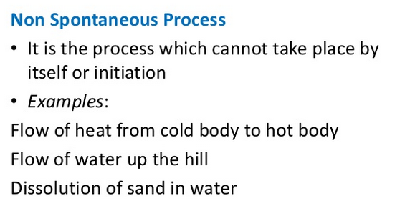

Slide 17
State and Path Function
State Function:
If the value of a particular property of a system depends only on the state ( Initial and final state) of the system at that instant and does not depend on the path by which it is carried out, then this property is called state function.
Example: Internal energy, enthalpy, entropy, free energy

Slide 18
State and Path Function
Path Function:
When the value of a property of a system depends on the path by which it is carried out, then the property is called Path function.
Example: Heat, Work etc.

Slide 19
State of a system
A thermodynamic system is said to be in a certain state when all its properties are fixed.
The fundamental properties which determine the state of a system are pressure (P), temperature (T), volume (V), mass and composition.
These are known as the state variables or thermodynamic variables.
Any change in these state variables are responsible for a system to change from the initial state to the final state.

Slide 20
Classification of State Variables
Independent state variable:
Consider one mole of a pure gas. – To define this system completely, the state variables such as P,V,T should be needed. There is no need to state the composition, as it is fixed automatically as per cent.
Therefore, the equation of state for one mole of a pure gas is given by the equation PV =RT , Where, R is a gas constant.
If P and T are specified, then the value of V is automatically fixed and can be calculated from the equation of state.
Hence, the variables such as P and T which must be specified in order to define the state of the system are called Independent state variables.
2. Dependent State Variable:
The variable which depends on the value of P and T is called dependent state variable.

Slide 21
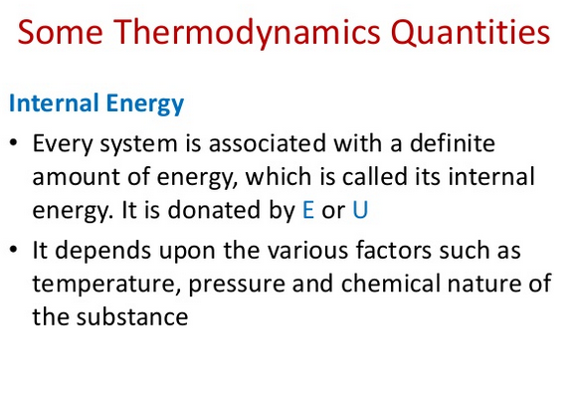

Slide 22
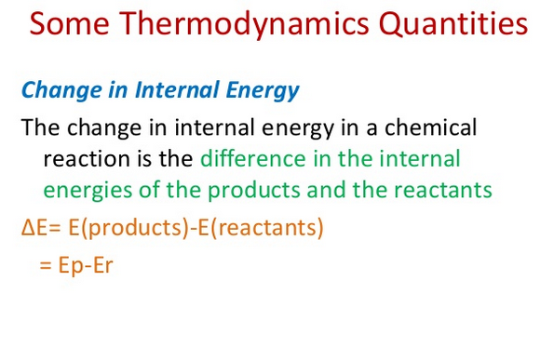

Slide 23
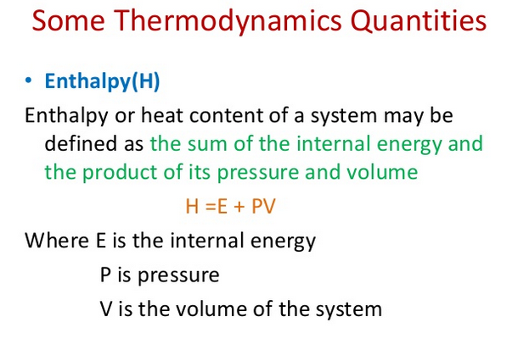

Slide 24
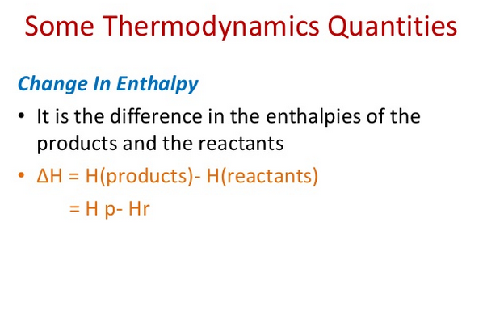

Slide 25
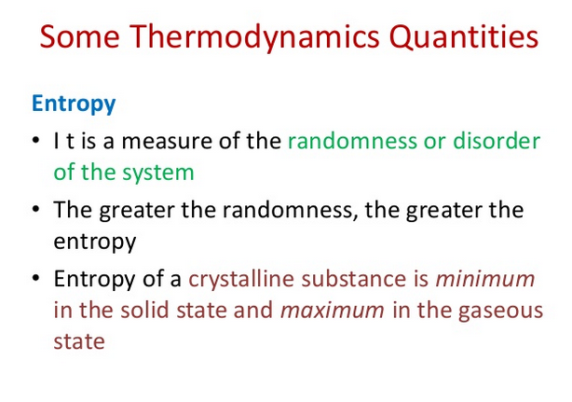

Slide 26
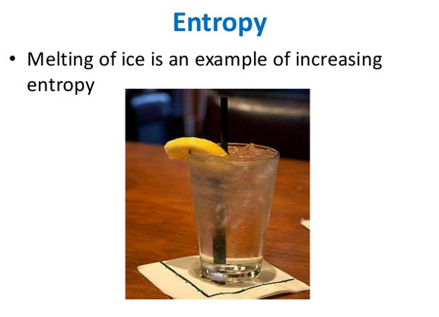

Slide 27
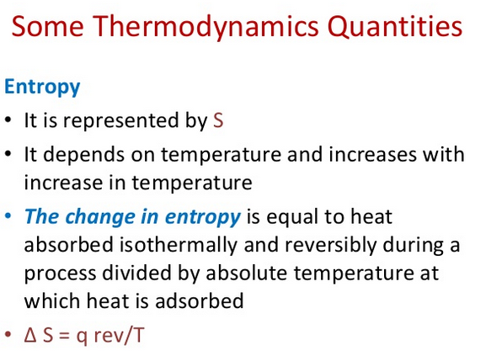

Slide 28
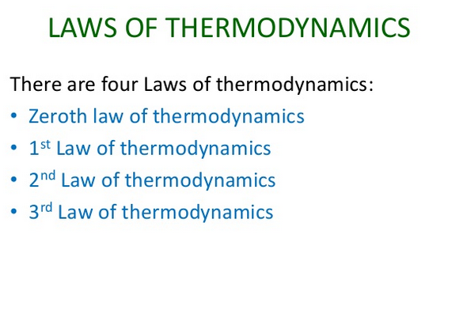

Slide 29
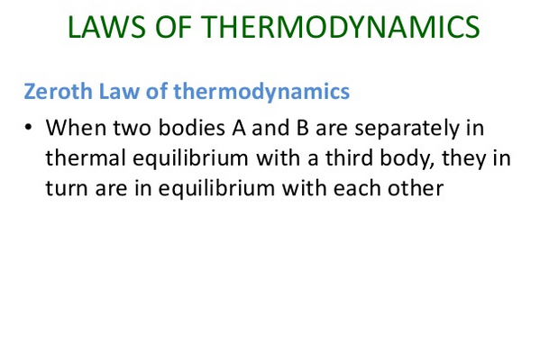

Slide 30
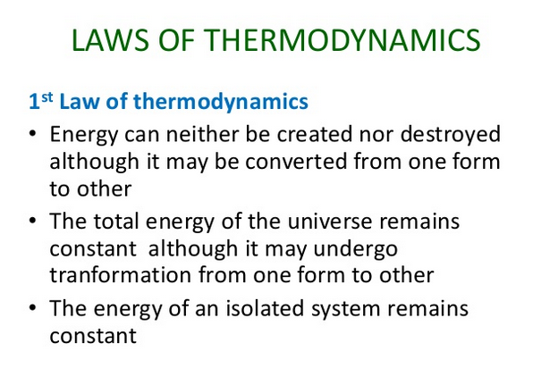

Slide 31
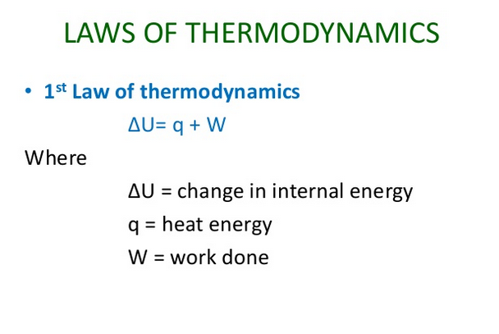

Slide 32
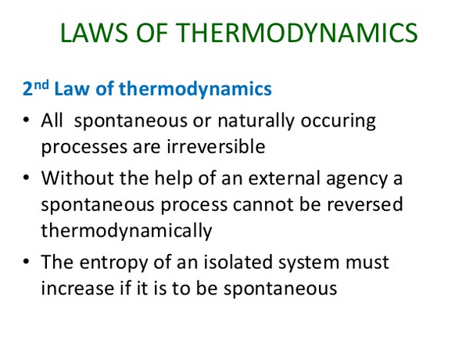

Slide 33
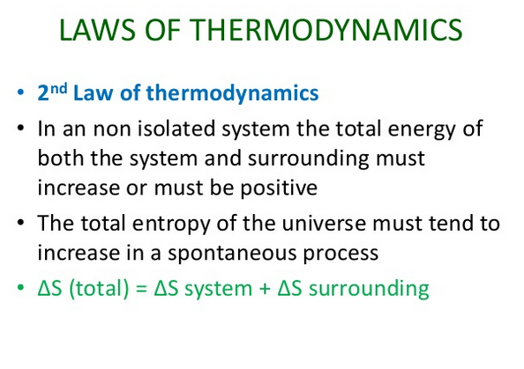

Slide 34
